Slide 1
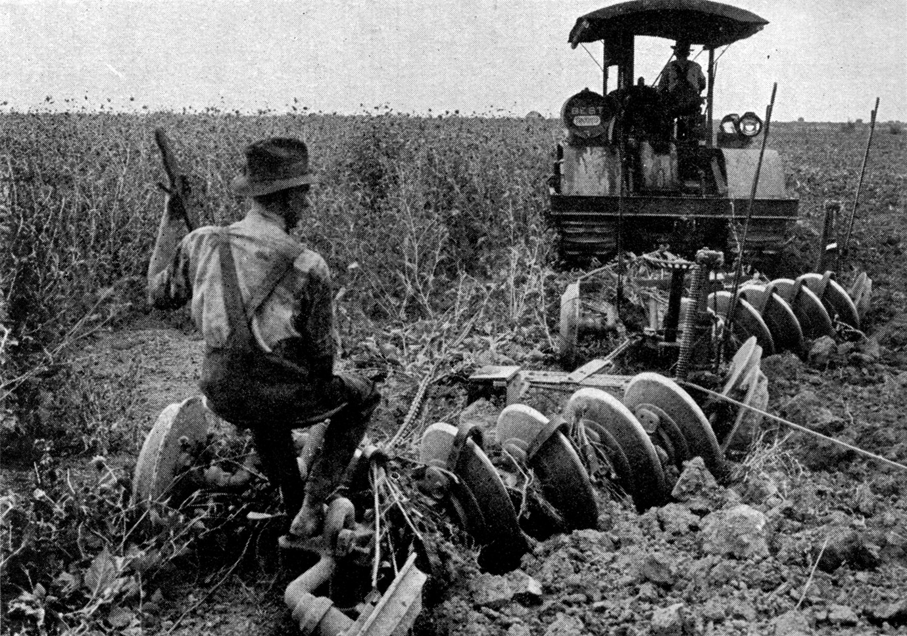

CODE CATALYST
This Photo by Unknown Author is licensed under CC BY-SA

Slide 2
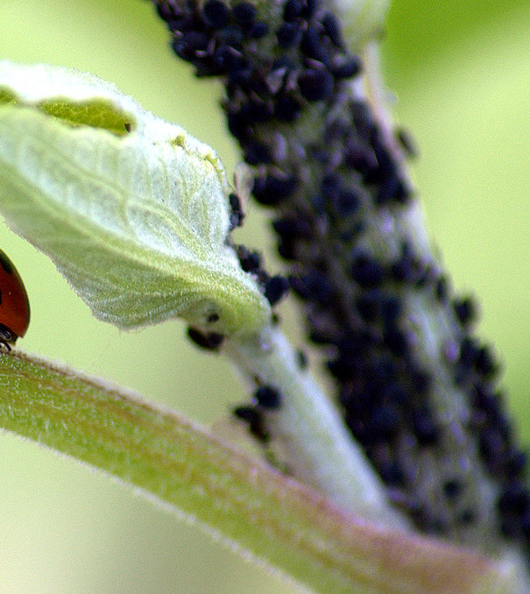
AGENDA
To develop a user-friendly Pest Detection App that utilizes AI to identify and provide information on pests through image analysis, helping farmers, gardeners, TO CONTROL pest.
This Photo by Unknown Author is licensed under CC BY-NC

Slide 3
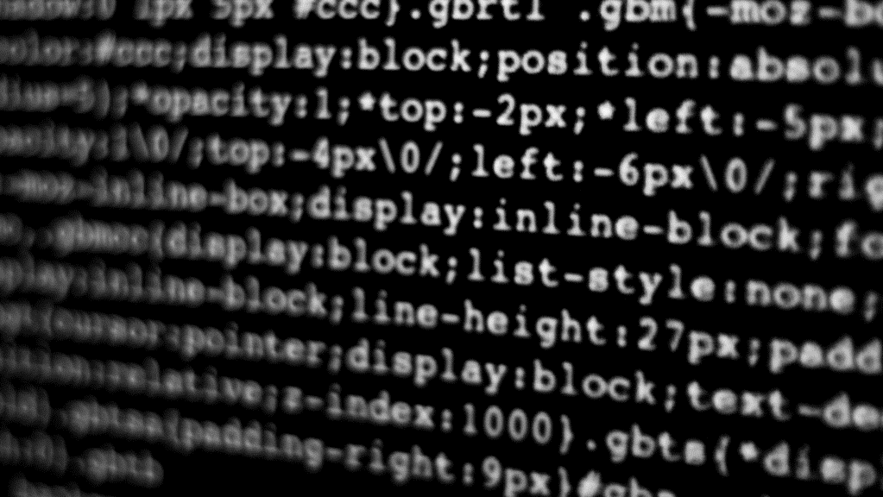
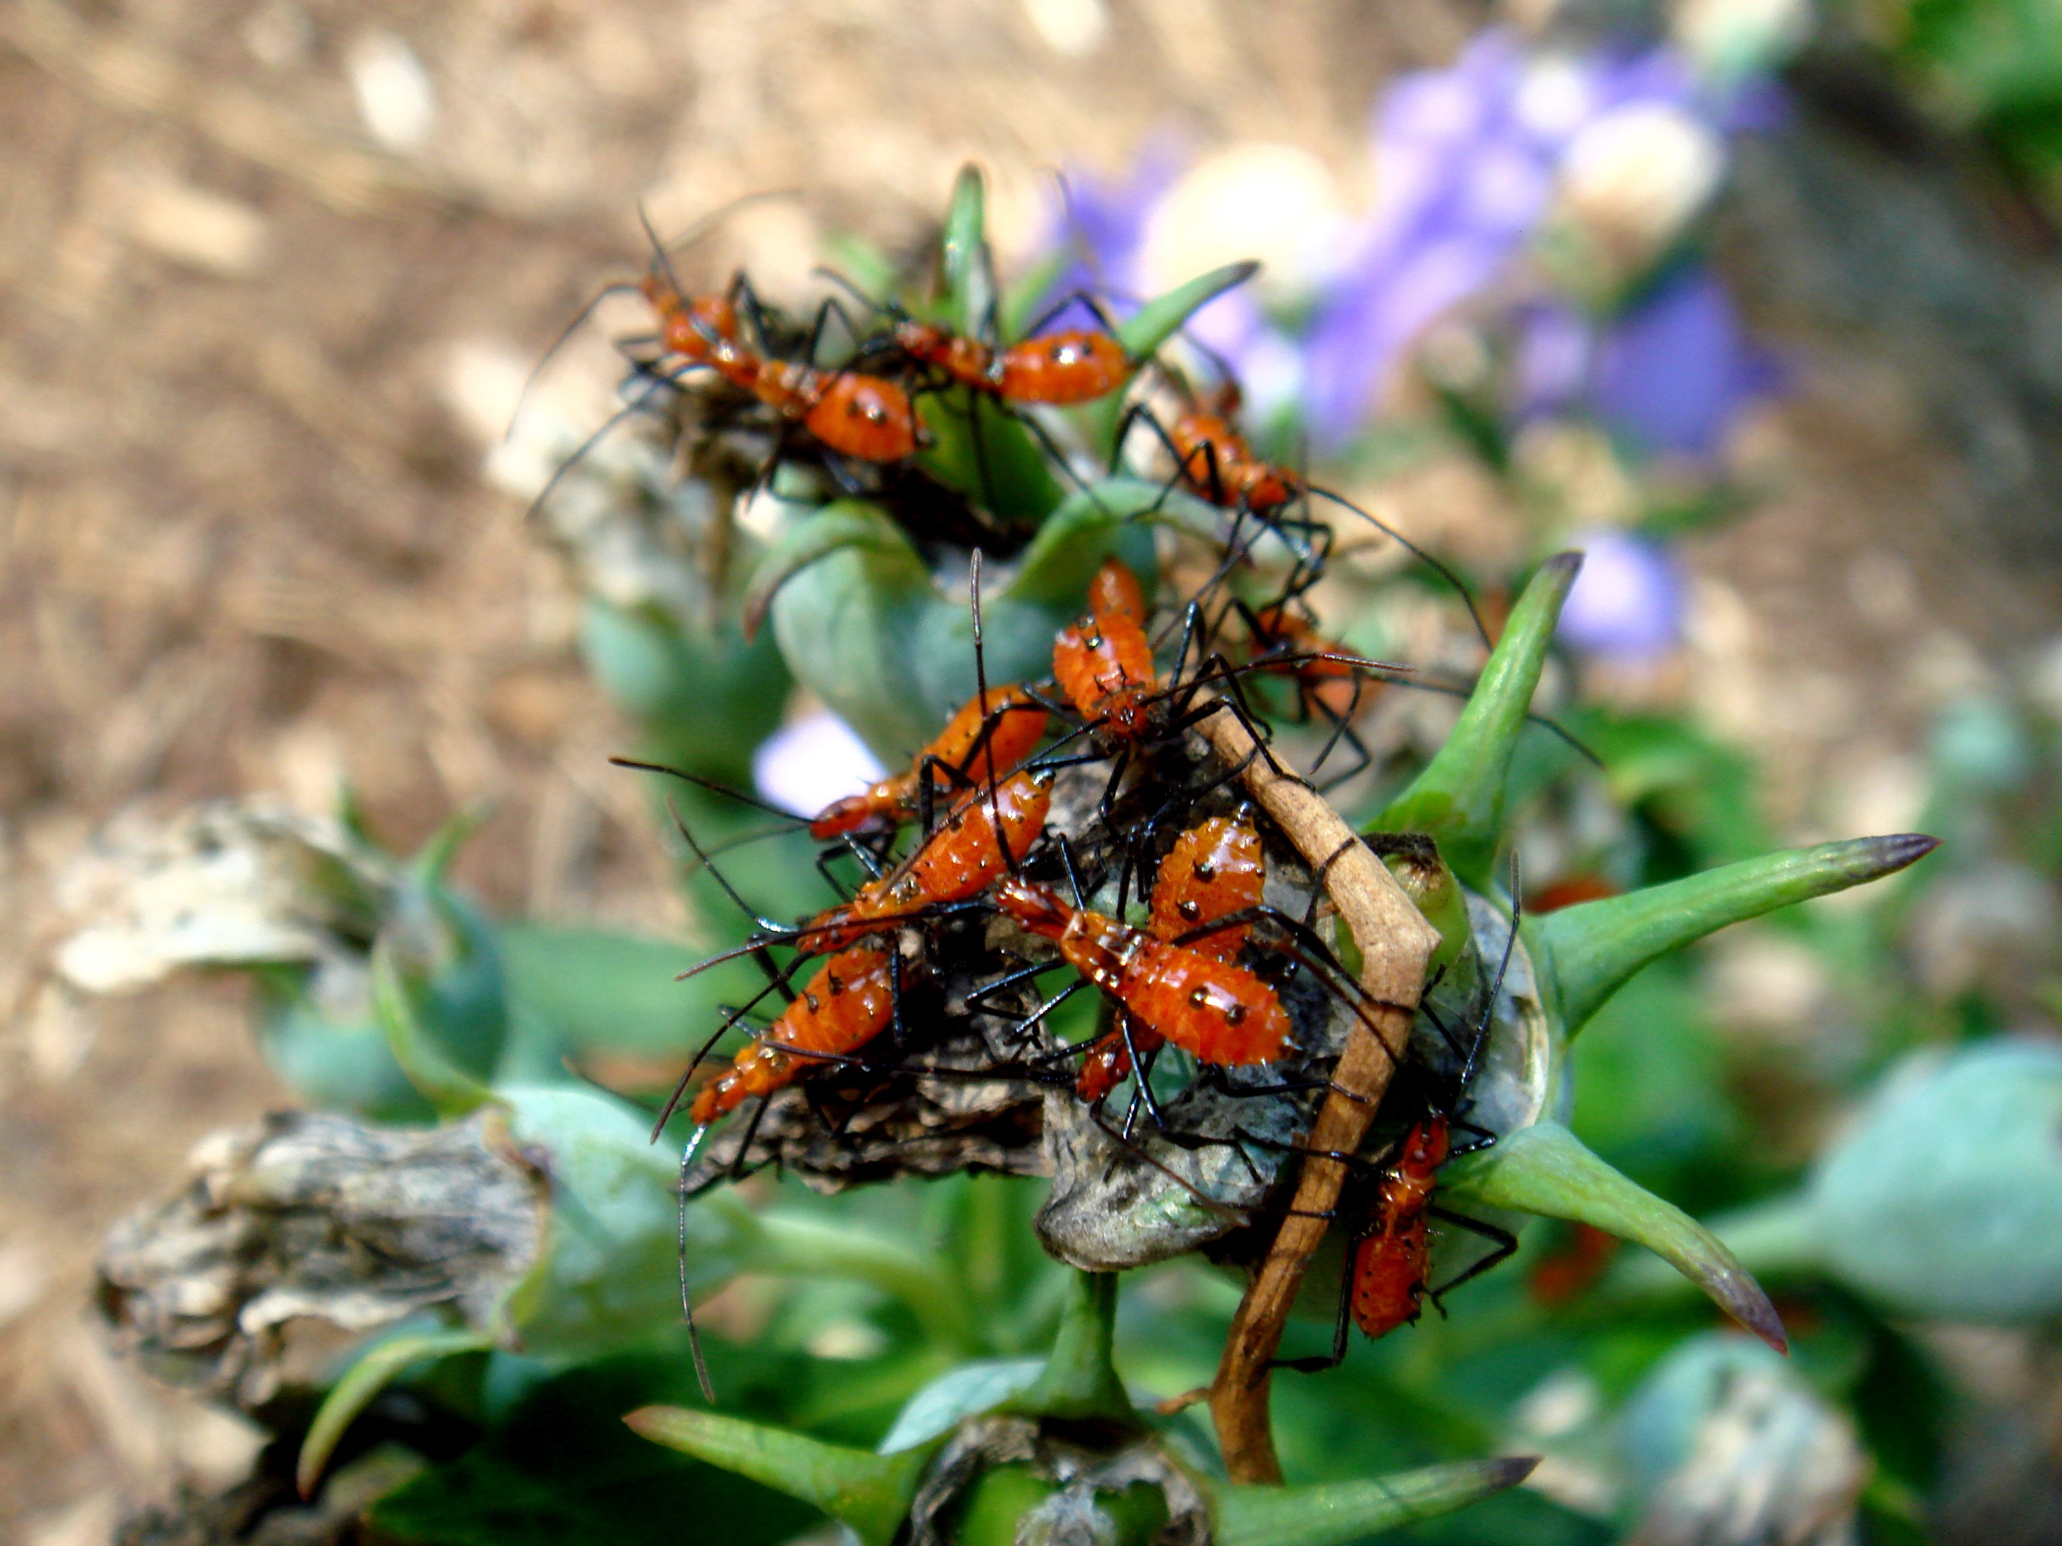
Problems

Slide 4
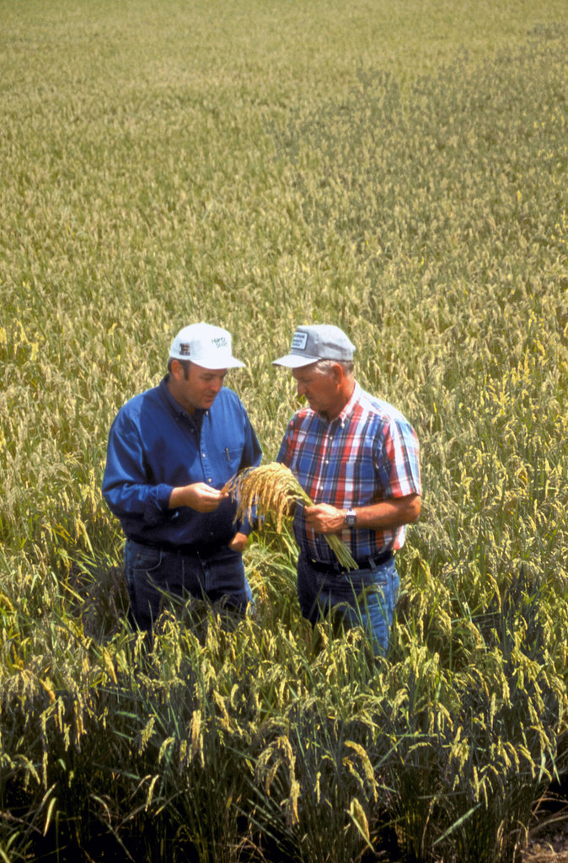
Farmers and gardeners face crop damage and loss due to pests, leading to economic loss and food scarcity. Up to 20-40% of crop yield is lost to pests annually. Lack of accessible, fast, and reliable pest detection for early intervention.
Pest detection web application
This Photo by Unknown Author is licensed under CC BY

Slide 5

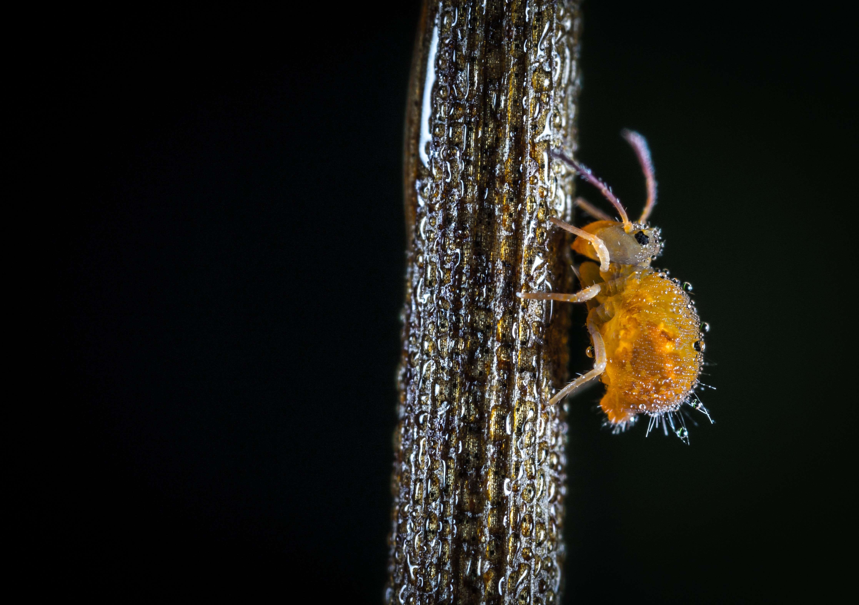
SOLUTION
TO MAKE AN AI DRIVEN WEB APPLICATION THAT IDENTIFY PEST USING IMAGE RECOGNATION.
PROPOSITION
QUICK ON THE SPOT PEST IDENTIFICATION
DATABASE OF COMMON PEST
SUGGESTION FOR PEST MANAGEMENT.

Slide 6

Workflow and Architecture
Capture image ➔ AI model processes ➔ Identify pest ➔ Display info and suggested actions.

Slide 7

DESCRIPSION
Pest Detection App is an AI-powered mobile application designed to help farmers and gardeners quickly and accurately identify pests affecting their crops. By using image recognition technology, users can capture a photo of a pest, and the app will analyze it to identify the species and provide details, such as common symptoms, potential crop damage, and recommended control measures. The app also includes a comprehensive pest database, location-based alerts for regional pest outbreaks, and tracking features to monitor pest issues over time. This tool empowers users with actionable information, helping reduce crop loss and improve pest management efficiency.

Slide 8

Impact
Environmental Impact: Reduces unnecessary pesticide usage by providing targeted pest control suggestions.
Sustainability: Supports sustainable agriculture by promoting eco-friendly practices."
Know your material in advance
Anticipate common questions
Rehearse your responses

Slide 9
DATA
CROPS | MEASUREMENT | PEST | TARGET
MAIZE | Percentage (%) | 20-30 | 5-12
FRUITS | Percentage (%) | 15-20 | 3-7
WHEAT | Percentage (%) | 30-35 | 15-20
PRODUCTION | Percentage (%) | 35 ( LOSS ) | 90
PROFIT | Percentage (%) | DOWN BY 25 | 5

Slide 10

THANK YOU
TEAM CODE CATALYST
HARSHVARDHAN TIWARI
AADIL HUSSAIN
MK. JAYADEEP

